Slide 1


RBQM Workshop
Building Open-Source Tools paired with Central Monitoring Best Practice
Jeremy Howells, Roche
Björn Koneswarakantha, Roche
Chris Wells, Roche
Mariia Lapaeva, Roche
Lawrence Dennison-Hall, Roche
Pekka Tiikkainen, Bayer
Frederik Collin, Boehringer Ingelheim
phuse.global/working_groups

Slide 2
Getting Started
Set up Project on Posit Connect
Open Repo: https://github.com/OpenRBQM/openRBQM-workshop-EU25
Open Link to Posit Cloud Project
Log in/Create an Account
Click on the 'assignment' to make yourself a copy
Follow along with hands on exercises

Slide 3
Agenda
5 min – OpenRBQM/IMPALA – Jeremy Howells
10 min – RBQM Overview – Chris Wells
5 min – Introduction {gsm} – Björn Koneswarakantha
15 min – Hands on Analytics – Mariia Lapaeva
15 min – Deep Dive – Björn Koneswarakantha
10 min – Introduction {ctas} – Pekka Tiikkainen
20 min – Hands on Analytics – Pekka Tiikkainen
10 min – Wrap-up – Jeremy Howells

Slide 4
Workshop Objectives
Understand what RBQM is and how it’s done
Learn about open-source collaboration and contribution
Learn how to evaluate KRIs on your own studies
Learn how to detect anomalies in your clinical trial data

Slide 5


Cross Industry Organisation
Founded 2022
19 industry members
https://impala-consortium.org/
Statistical Open Source Packages
Scientific Publications
Quality Frameworks (RAPID, Quality Briefs)
Joint Health Authority Engagement
Founded 2024
> 3 industry members
RBQM focus (Critical to Quality, Centralized Monitoring, Quality Tolerance Limits)
6 Projects
Open Source Packages

Slide 6
Part 1 - Intro To RBQM & CM
Chris Wells

Slide 7
RBQM
Increased study quality
What is RBQM?
Focuses Resources on Most Impactful Activities
Early ID of Issues
Prevents Gaps &
Recurrence
An adaptive, cross-functional, study monitoring process that begins with protocol design, identifies areas most critical to the study, & directs monitoring focus to risks & factors critical to safety & quality.
Benefits of RBQM
Leverages technology for ongoing remote data surveillance & comprehensive risk management throughout the trial lifecycle.
Standardized Tools & Systems
Improved
Operational
Efficiency
Employs various tools, platforms and dashboards to identify signals, which indicate potential issues.
Alignment to Current & Future
Regulatory
Expectations
Allows study teams to concentrate on high value tasks and focuses resources on activities with the most potential to impact patient safety and data quality.

Slide 8

Quality
Quality is the absence of meaningful errors.

Slide 9
CtQ: Data & Process
Critical Data
Critical Process
Data deemed important to the reliability of the study findings, specifically those that support primary and key secondary endpoints, as well as data related to safety and key eligibility criteria.
(exploratory/tertiary Endpoints are not considered critical)
Any process that is essential to the reliability of study findings and/or related to ensuring participant safety and rights
Examples:
Informed consent process
Randomization process
Protocol specific intervention or procedures
Dosing

Slide 10

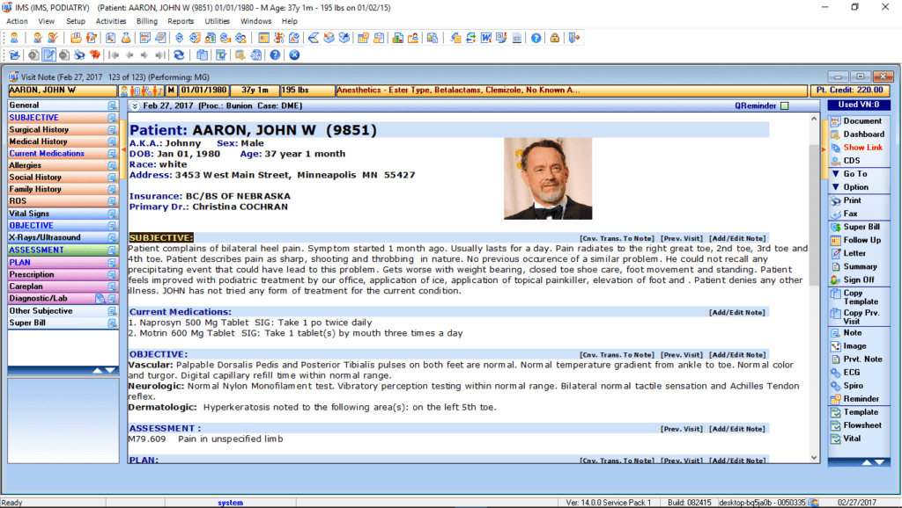
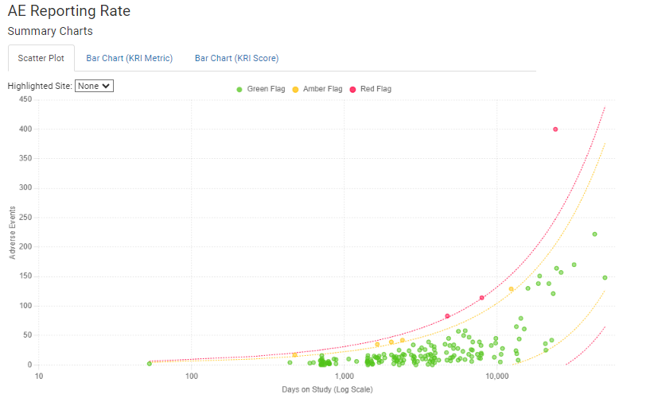
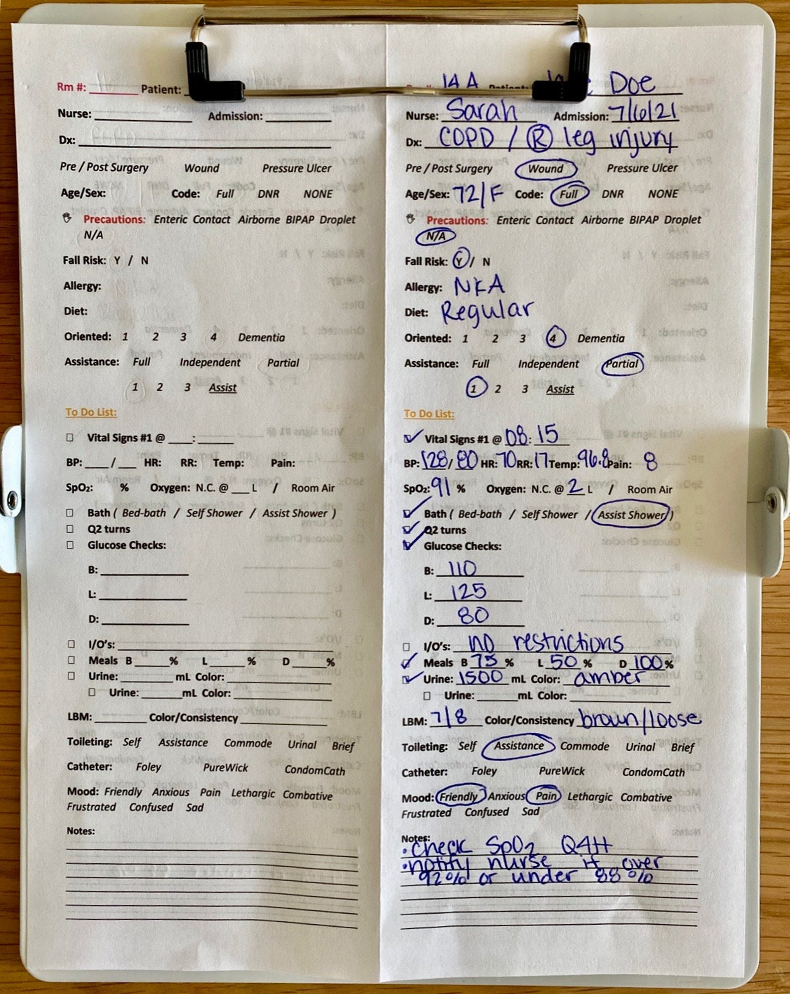
Centralized Monitoring (CM)
Centralized monitoring is a holistic view of the data used to identify trends, patterns, unusual variation in the data (aligned with ICH)
This is a vantage point that operations teams do not have
Helps operations teams target specific process risks at the study, region, country, or site level
Should focus primarily on the CtQ factors identified for the study
What CRAs see is extremely limited.
CM Enables a Unique, Holistic View.

Slide 11
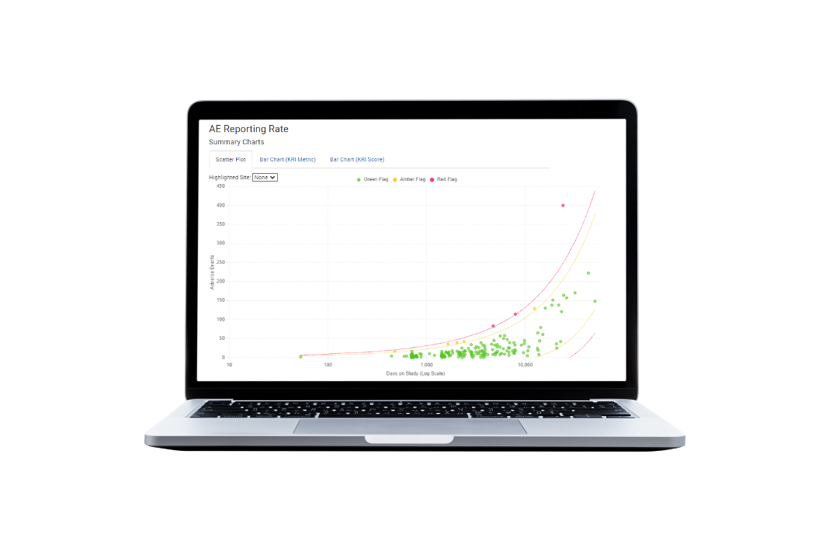


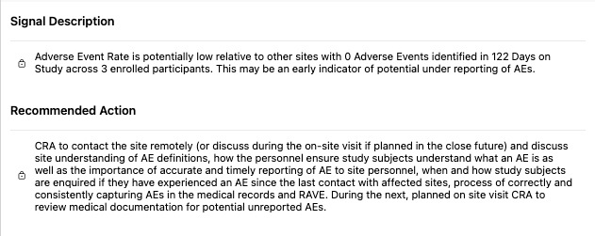

Taking Action on CM Signals
Central Monitor evaluates data signal & translates into something operational teams can easily understand and action.
Signal is tracked in CTMS (or other system) where it becomes a part of the CRA’s regular site monitoring process.
The CRA then evaluates the site’s process with the study coordinator and/or PI via RCA to evaluate potential gaps. Mitigation is then implemented.

Slide 12
Part 2 – Good Statistical Monitoring {gsm}
Björn Koneswarakantha

Slide 13
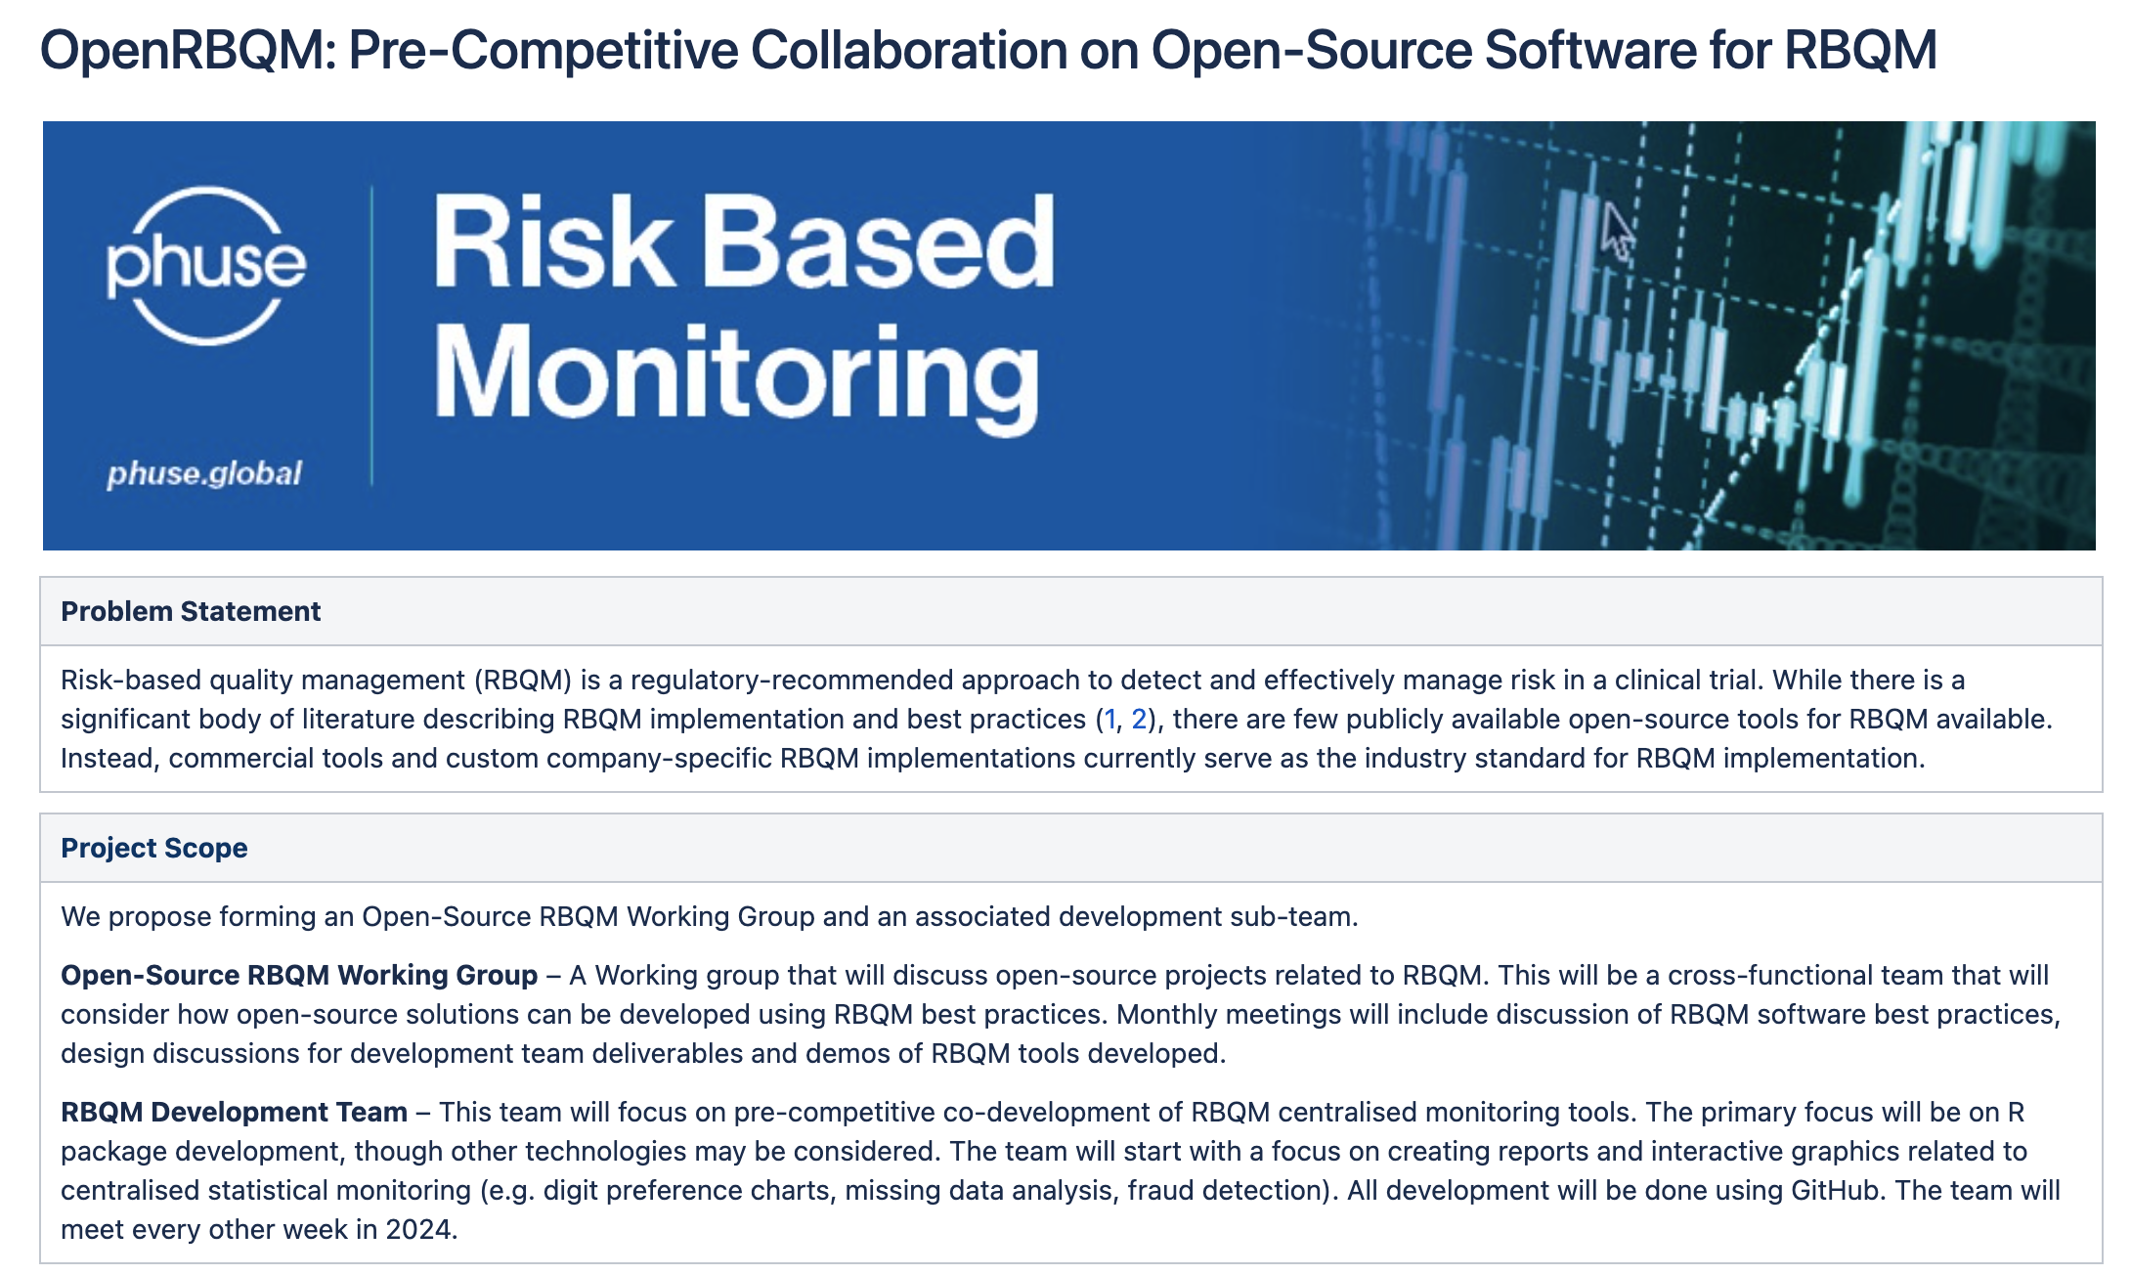

Slide 14
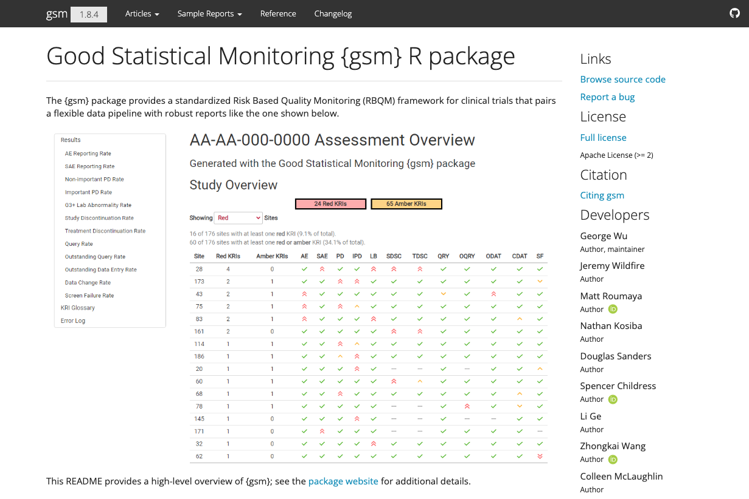
The Good Statistical Monitoring or “gsm” package is a free and open-source framework for RBQM analytics. The package provides a standardized Risk Based Quality Monitoring (RBQM) framework for clinical trials that pairs a flexible data pipeline with interactive reporting.
Learn more at https://gilead-biostats.github.io/gsm.core/

Slide 15


Slide 16


Slide 17
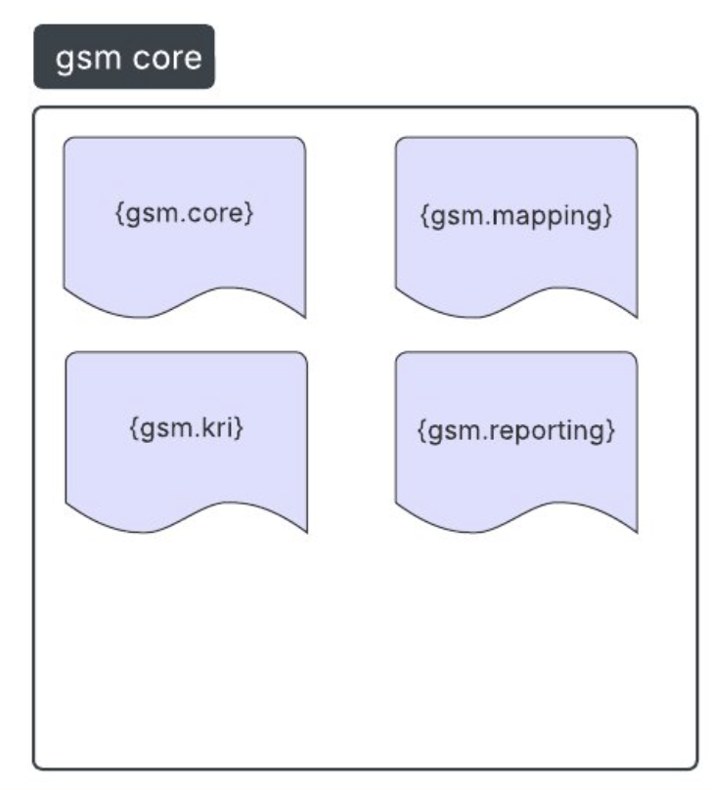
{gsm} is now {gsm.core}

Slide 18
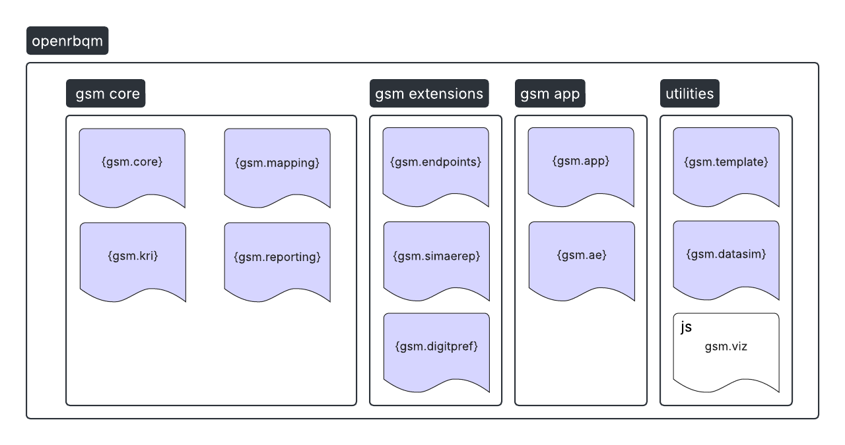
A. i

Slide 19
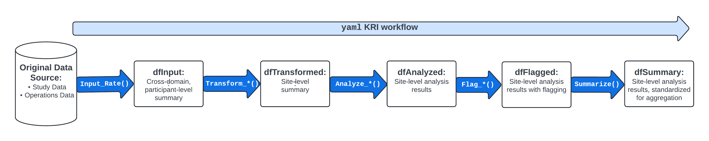
Analysis Pipeline

Slide 20
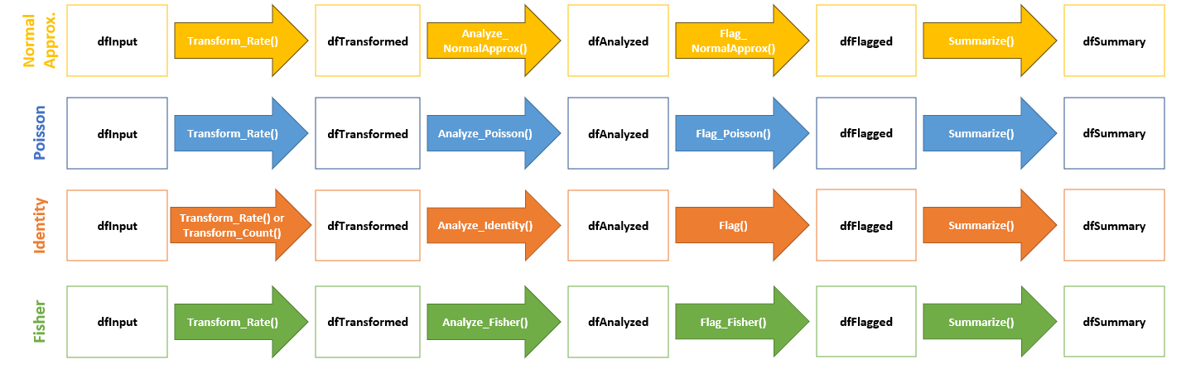
Statistical Models Available For Each Assessment
{gsm.simaerep}
Bootstrap
dfMapped
Input_CumCount()
dfInput
Analyze_Simaerep()
dfAnalyzed
Flag_Simaerep()
dfFlagged
Summarize()
dfSummary

Slide 21
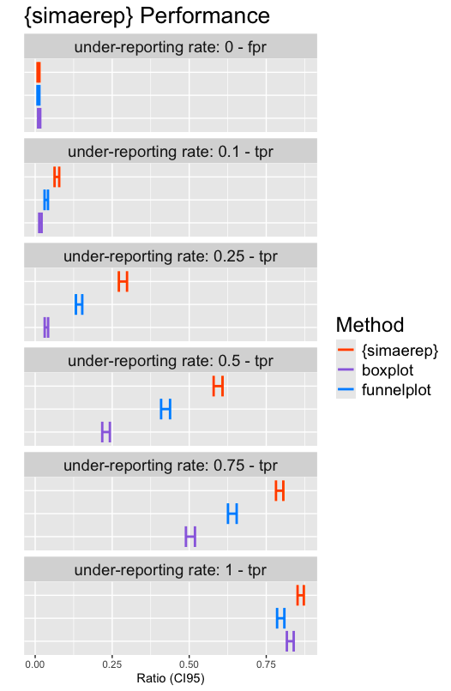





{gsm.simaerep} bootstrap
Bootstrap Simulations Redistribute Patients between sites
Higher Performance than traditional outlier detection methods
Presented at PHUSE EU Connect 2024
https://github.com/IMPALA-Consortium/gsm.simaerep
https://phuse.s3.eu-central-1.amazonaws.com/Archive/2024/Connect/EU/Strasbourg/PRE_AR04.pdf
True positive rate (tpr), false positive rate (fpr)

Slide 22
Package Developers
Study Analysts (DM, SP, Bios)
RBQM / CM team
Study Team
IT / Quality
CRO Partners
Technical Implementation
RBQM Process

Slide 23
Individual Analyst
Enterprise Framework
OpenRBQM
Technical Use Cases

Slide 24
Part 3 – {gsm} Analytics
Mariia Lapaeva

Slide 25
Overview
How to create and run single metric
Analysis pipeline overview
Hands-on
Open Posit Workbench
Review the setup/file structure
Run analysis pipeline
Review KRI report

Slide 26
Create and Run Single Metric
Open and explore `sae-kri.R` file:
source() data from 'R/DataIO.R’ to load data input/output helpers
Use gsm.core::Input_Rate() function to calculate SAE reporting rate
Use gsm.core::Transform_Rate() to transform the input for analysis
Use gsm.core::Analyze_NormalApprox() to analyze the transformed data using normal approximation
Use gsm.core::Flag() to flag sites based on thresholds with threshold values of c(-3, -2, 2, 3)
Note: AE KRI transformed into SAE KRI by applying filter to aeser variable
Resources: Step-by-Step Analysis Workflow

Slide 27
Part 3 – {gsm} Deep Dive Pipelines
Björn Koneswarakantha

Slide 28
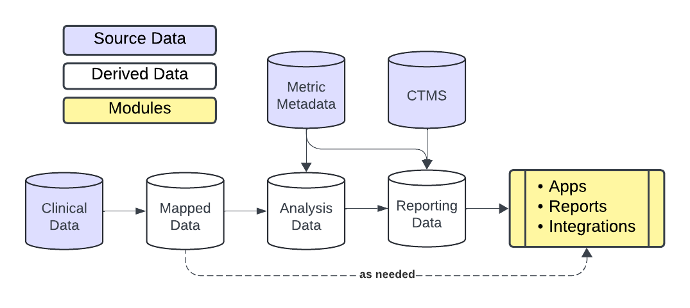
Analysis Pipeline

Slide 29
Analysis Pipeline
Study/Site Metadata
SDTM

Slide 30
Analysis Pipeline
Data prep

Slide 31
Analysis Pipeline
Evaluate KRIs

Slide 32
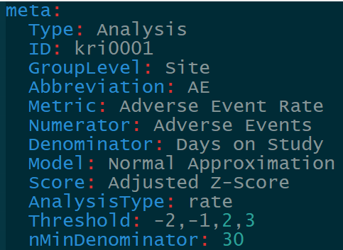
Analysis Pipeline

Slide 33
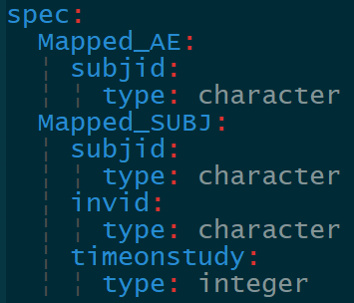
Analysis Pipeline

Slide 34
Analysis Pipeline

Slide 35
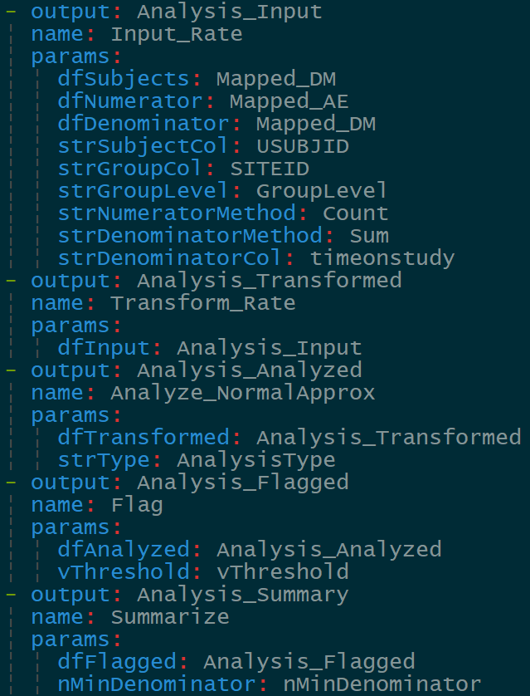
Analysis Pipeline

Slide 36
Analysis Pipeline
Compile data

Slide 37
Analysis Pipeline
Generate report

Slide 38
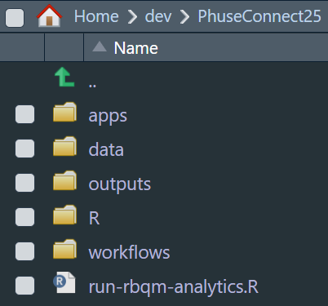
Hands-on
Open Posit Workbench with requisite packages in the OpenRBQM ecosystem installed
Review the setup/file structure

Slide 39
Hands-on
Run analysis pipeline
View Files (CMD/CTRL+SHIFT+5)
Click run-rbqm-analytics.R
Run each step interactively
Open report in ./outputs

Slide 40
Hands-on
Create a new KRI: SAE Reporting Rate (time permitting)
Under./workflows/2_metrics copy adverseEventReportingRate.yaml and rename seriousAdverseEventReportingRate.yaml
Open the new workflow and update the information in meta
Add aeser to data spec for Mapped_AE
Add a new step that filters Mapped_AE on serious AEs
Pass the output of the step above to the dfNumerator of Input_Rate
Rerun analysis pipeline

Slide 41
Part 4 – {ctas} Time series anomalies
Pekka Tiikkainen

Slide 42
Clinical Trial Anomaly Spotter (CTAS)
CTAS (Clinical Trial Anomaly Spotter) is a CSM tool focused on identifying anomalous time series of continuous variables.
“Unsupervised” tool which does not use pre-specified KRIs. The identified anomalies can be such that were not anticipated during study design.
Our vision for CTAS: a widely accepted open-source for tool for time series anomaly detection used by both the industry and regulators alike.
May 2022 In production at Bayer
Nov 2022 Presented at PHUSE EU Connect 22 [1], [2]
Jul 2023 Shared for co-development with IMPALA partners
Dec 2023 R package published [3]
[1] https://phuse.s3.eu-central-1.amazonaws.com/Archive/2022/Connect/EU/Belfast/PRE_AR04.pdf [2] https://phuse.s3.eu-central-1.amazonaws.com/Archive/2022/Connect/EU/Belfast/PAP_AR04.pdf [3] https://github.com/IMPALA-Consortium/ctas

Slide 43
Who is CTAS for?
Quality Assurance
Choose sites for inspections and audits.
Guide audits and inspections to focus on parameters with most anomalies.
Clinical Operations
Monitor study data of on-going trials for signs of issues. Act early on to minimize impact to project.
Identify anomalies that would potentially go undetected with more traditional methods.
Regulators
Screen submissions for anomalies in (critical) parameters.
Motivate sponsors to use advanced tools like CTAS to pre-emptily avoid data findings during submission.
Reduce manual data review.

Slide 44
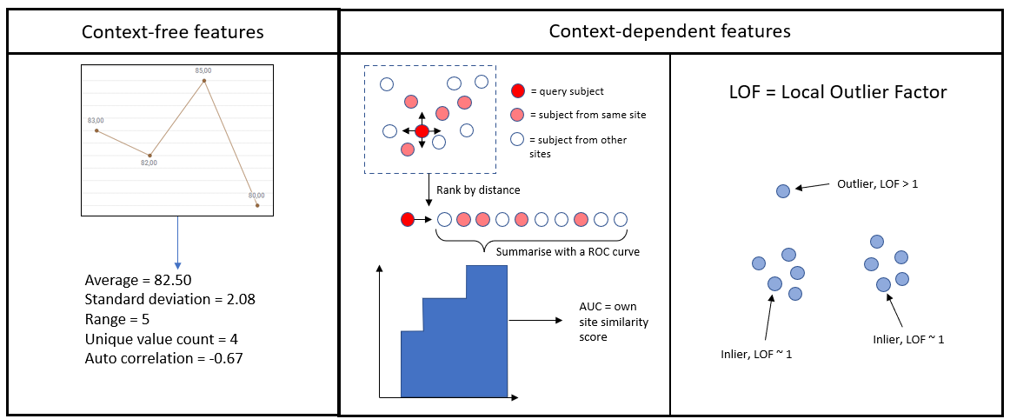
CTAS algorithm – time series features

Slide 45
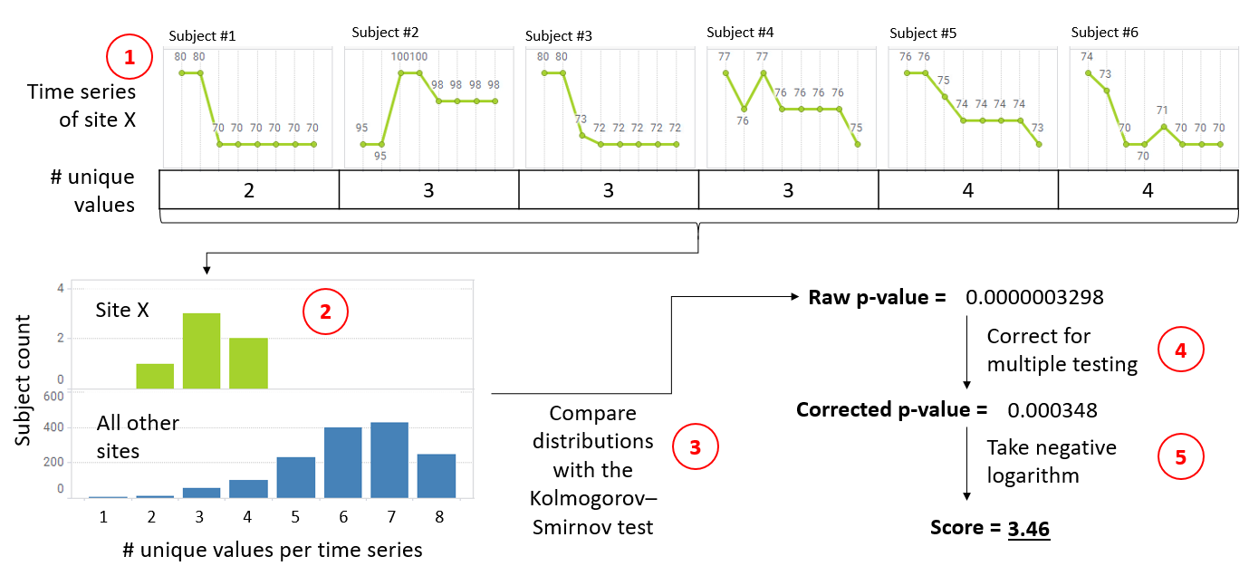
CTAS algorithm – flagging sites

Slide 46
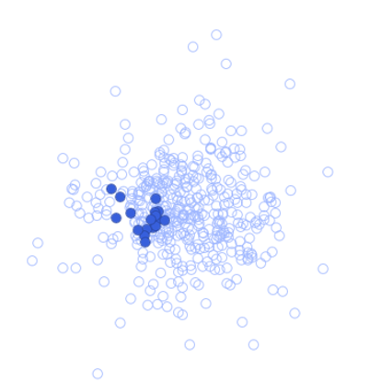
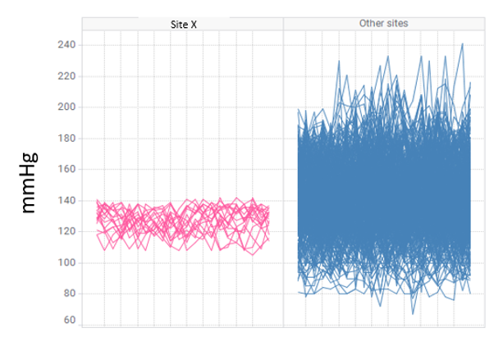
Examples of anomalies identified with CTAS
Site with co-clustered blood pressure profiles (Bayer)
Potential reasons: result fabrication, “sample” splitting, bias in subject selection

Slide 47
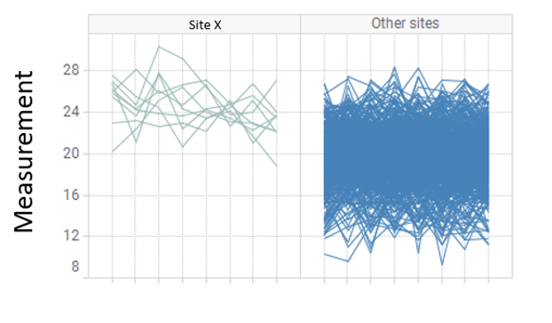
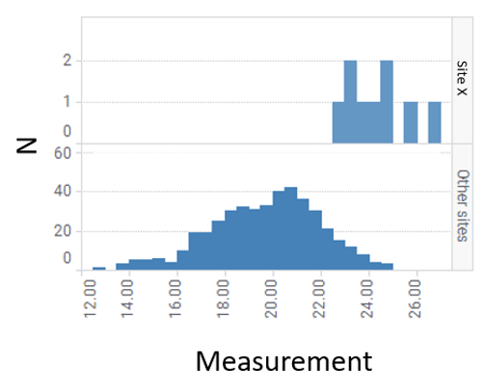
Examples of anomalies identified with CTAS
Site with unusually large laboratory assay results (Bayer)
Potential reasons: bias in subject selection, in-correct assay calibration (local labs), errors in sample handling (central labs)

Slide 48
Hands-on
Run analysis pipeline
View Files (CMD/CTRL+SHIFT+5)
Click ctas_workshop.R
Run each step interactively

Slide 49
BREAK

Slide 50
Part 4 – Deep Dive with {gsm.app}
Jon Harmon

Slide 51
Overview
{gsm.app} overview
Hands-on
Demo app.
Customizing for your data.
Plugins.

Slide 52
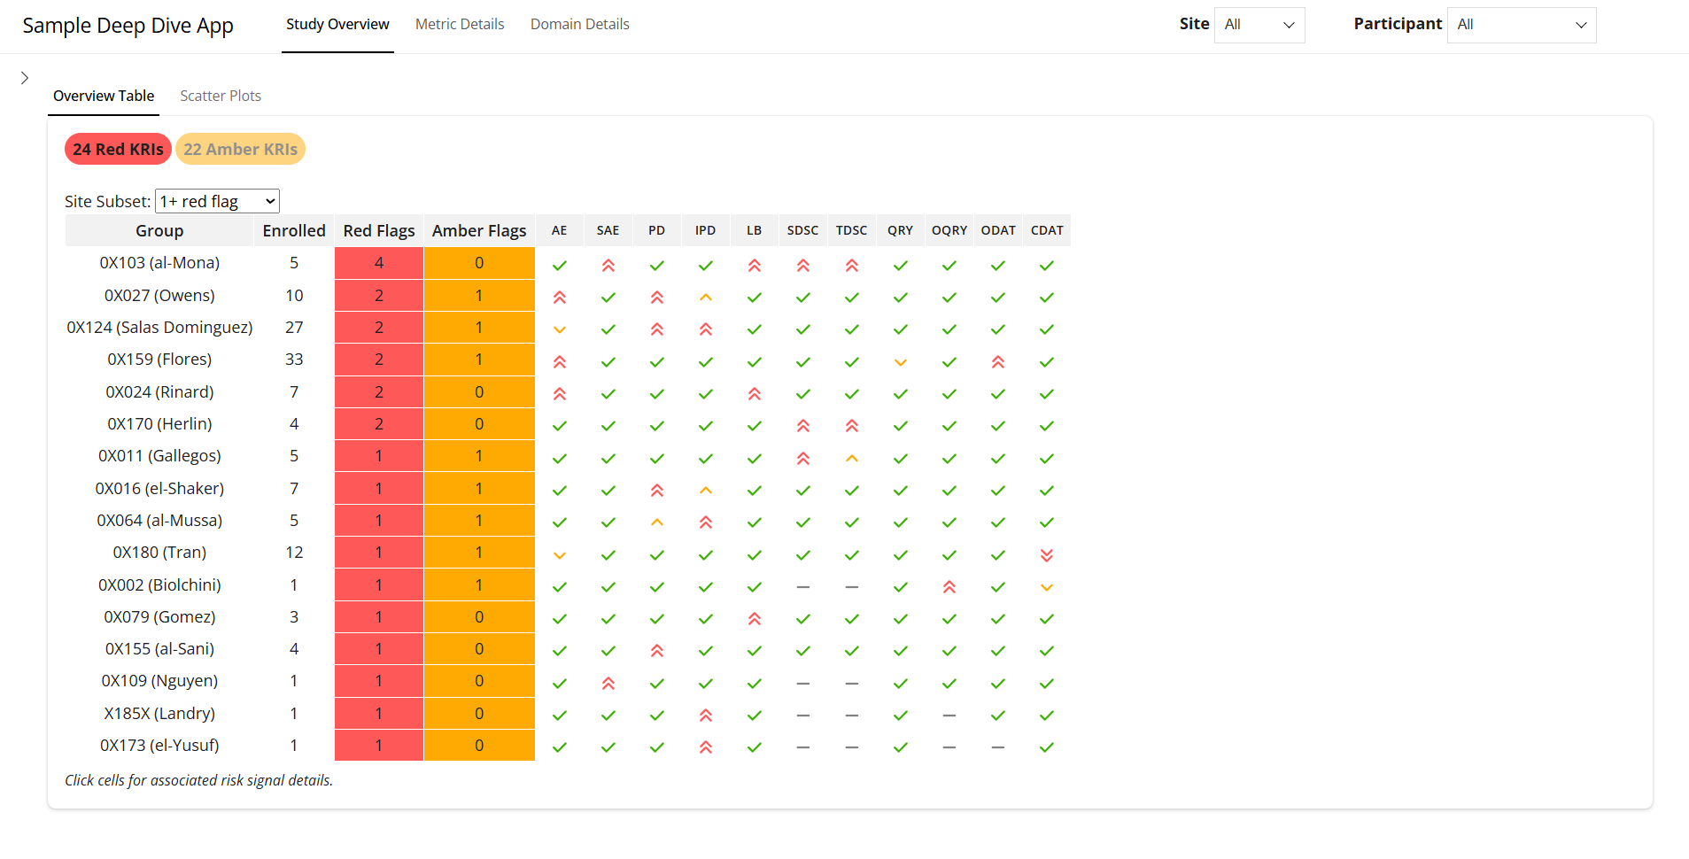
{gsm.app}
Deep-dive shiny app for investigating risk signals.
Designed to work with other gsm components.
Works with your data.
Plugin framework.

Slide 53
Hands-on: Demo app
apps/1_demo/app.R
"Run App" (or ctrl-shift-R).
This version uses sample data.
Explore.

Slide 54
Hands-on: Fetch Function
apps/2_workshop_data/app.R
"Run App" (or ctrl-shift-R).
fetchData function passed into run_gsm_app
Customize to change how domain data is fetched
Explore.

Slide 55
Hands-on: Plugins
apps/3_plugins/app.R
"Run App" (or ctrl-shift-R)
lPlugins = list(pluginAE())
Allows for customization of deep dive tabs
Note tweak to fetchData function!
Explore.

Slide 56
Part 5 – Cloud-based Automation
Devin Pastoor

Slide 57
Cloud-based Automation
RBQM is a continuous process
Requires ongoing evaluation of KRIs
Prime candidate for automation
Setup of cloud-based environment with scheduled actions

Slide 58
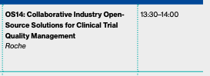
Thank You!
Course Material will stay available on github
Visit our Presentation to learn more
X12 Wednesday

Slide 59


